Slide 1

WoT Plugfest
TPAC 2019, Sept 2019
Michael McCool: Intel Principal Engineer / W3C WoT WG Co-chair

Slide 2
W3C Web of Things
Goal: Support IoT Interoperability via Open Standards
W3C WoT Interest Group (IG) https://www.w3.org/2016/07/wot-ig-charter.html
Started spring 2015
~200 participants
Informal work and outreach
“PlugFest” validation with running code
Exploration of new building blocks
“OpenDays” with external speakers
Liaisons and collaborations with other organizations and SDOs
Second Workshop on Web of Things held 3-5 June 2019 in Munich
Charter renewal submitted Sept 2019
W3C WoT Working Group (WG) https://www.w3.org/2016/12/wot-wg-2016.html
Started end of 2016 (effectively Feb 2017)
~100 participants
Normative work on specific deliverables
W3C Patent Policy for royalty-free standards
Only W3C Members and Invited Experts
Architecture and Thing Description were published as Candidate Recommendations on 16 May 2019
Notes published on Protocol Bindings, Security, and Scripting API
Charter renewal in progress; work items and deliverables under discussion

Slide 3

W3C Web of Things – Building Blocks
WoT Architecture
Overarching umbrella with architectural constraints and guidance on how to use and combine building blocks.
WoT Thing Description (TD)
Security Guidelines
WoT Scripting API
JSON-LD representation format to describe Thing instances with metadata. Uses formal interaction model and domain-specific vocabularies to uniformly describe how to use Things, which enables semantic interoperability.
Standardized JavaScript object API for an IoT runtime system similar to the Web browser. Provides an interface between applications and Things to simplify IoT application development and enable portable apps across vendors, devices, edge, and cloud.
Any IoT Device
Common Runtime
Application Script
Behavior
The index.html
for Things
Interaction Model
Data Model
WoT Binding Templates
Properties
Protocol Bindings
Capture how the formal Interaction Model is mapped to concrete protocol operations (e.g., CoAP) and platform features (e.g., OCF). These templates are re-used by concrete TDs.
Actions
Events
HTTP
…
CoAP
MQTT

Slide 4
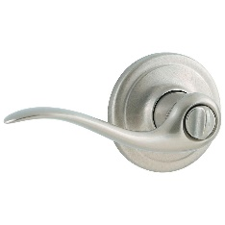
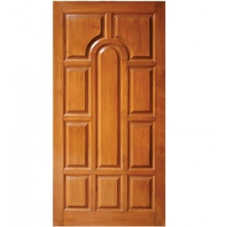

Published Candidate Recommendations
WoT Architecture
Constraints
Things must have TD (W3C WoT)
Must use hypermedia controls (general WoT)
URIs
Standard set of methods
Media Types
Interaction Affordances
Metadata of a Thing that shows and describes the possible choices (what) to Consumers, thereby suggesting how Consumers may interact with the Thing
WoT Thing Description (TD)
{
"@context": [
"https://www.w3.org/2019/wot/td/v1",
{ "iot": "http://iotschema.org/" }
],
"id": "urn:dev:org:32473:1234567890",
"title": "MyLEDThing",
"description": "RGB LED torchiere",
"@type": ["Thing", "iot:Light"],
"securityDefinitions": ["default": {
"scheme": "bearer"
}],
"security": ["default"],
"properties": {
"brightness": {
"@type": ["iot:Brightness"],
"type": "integer",
"minimum": 0,
"maximum": 100,
"forms": [ ... ]
}
},
"actions": {
"fadeIn": {
...
Pull
Handle = Affordance
What?
How?
Door = Thing
Open
Turn

Slide 5
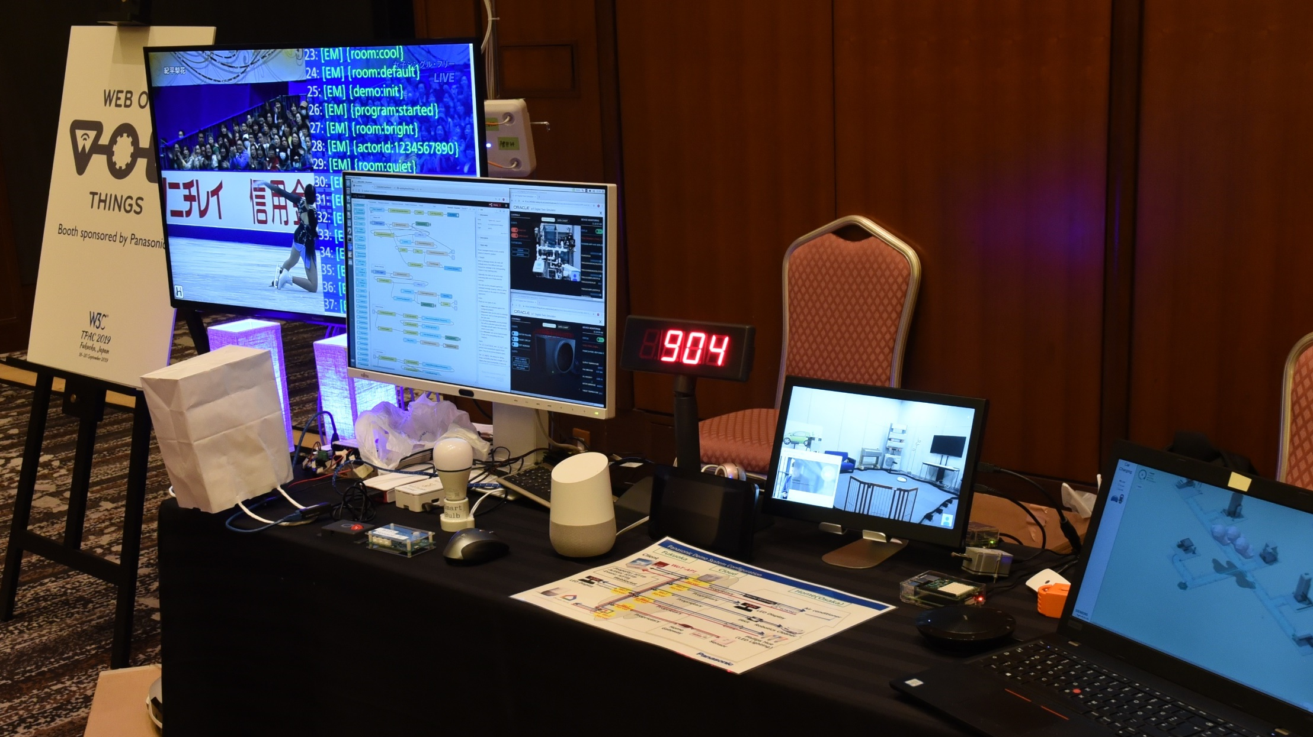
Plugfest, Use Cases, and Demos

Slide 6
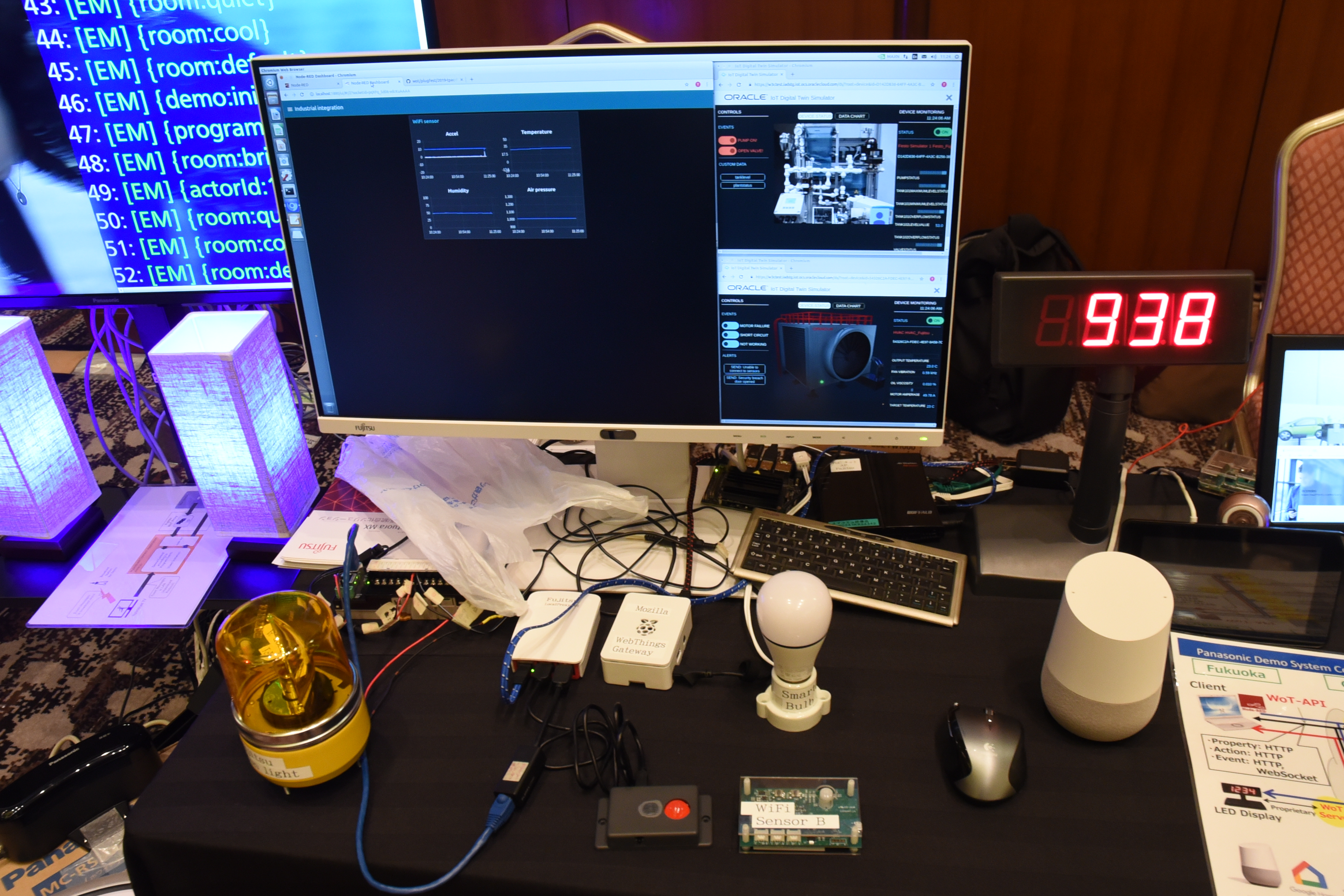

Slide 9
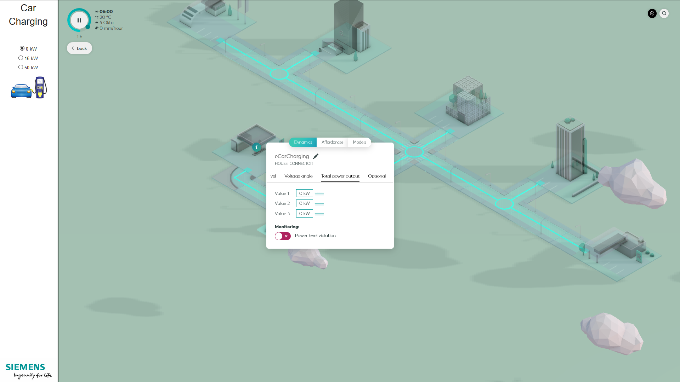

Slide 10
W3C WoT Resources
W3C WoT Wiki
https://www.w3.org/WoT/IG/wiki (IG/WG organizational information)
W3C WoT Interest Group
https://www.w3.org/2016/07/wot-ig-charter.html (charter)
https://lists.w3.org/Archives/Public/public-wot-ig/ (mailing list)
https://github.com/w3c/wot (technical proposals)
W3C WoT Working Group
https://www.w3.org/2016/12/wot-wg-2016.html (charter)
https://www.w3.org/WoT/WG/ (dashboard)
W3C WoT Candidate Recommendations
https://www.w3.org/TR/wot-architecture/
https://www.w3.org/TR/wot-thing-description/
W3C WoT Working Drafts / Group Notes
https://www.w3.org/TR/wot-binding-templates/
https://www.w3.org/TR/wot-scripting-api/
https://www.w3.org/TR/wot-security/
W3C WoT Editors’ Drafts and Issue Tracker
https://github.com/w3c/wot-architecture/
https://github.com/w3c/wot-thing-description/
https://github.com/w3c/wot-binding-templates/
https://github.com/w3c/wot-scripting-api/
https://github.com/w3c/wot-security/
Reference Implementation: node-wot
https://github.com/eclipse/thingweb.node-wot

Slide 11
Contacts
https://www.w3.org/WoT/WG/
Dr. Michael McCool
Principal Engineer
Intel
Technology Pathfinding
michael.mccool@intel.com
Dr. Matthias Kovatsch
Principal Researcher
Huawei Technologies
Applied Network Technology Lab
matthias.kovatsch@huawei.com

